Slide 1
Instructions – Remove this slide for the presentation
Objectives
In this exercise, you are asked to
provide answers to questions using an article from the scientific literature
synthesize and present these results during the course
In particular, your group will focus on Topic 2: “The “realism” of the indicators” and use the following reference :
DESROSIÈRES, A. (2001). How Real Are Statistics? Four Possible Attitudes. Social Research, 68(2), 339–355. http://www.jstor.org/stable/40971461
(access through your EPFL account)
The following slides contain questions as well as indications on which section to read.

Slide 2
Instructions – Remove this slide for the presentation
Step 1
5 groups (2 by topic) 1A, 1B ; 2A, 2B
Step 2
Step 3
Step 4
Step 5
By groups : Reading
Group formation
By groups: discussing and answering the questions
By topic : Merge the groups by topic
Presentation of the works (15 min / topic max + 3 min questions)
Preparation of the presentation
Access the papers on the website through your EPFL account
Use these slides to present
Merge your slides and organize your self for the presentation

Slide 3
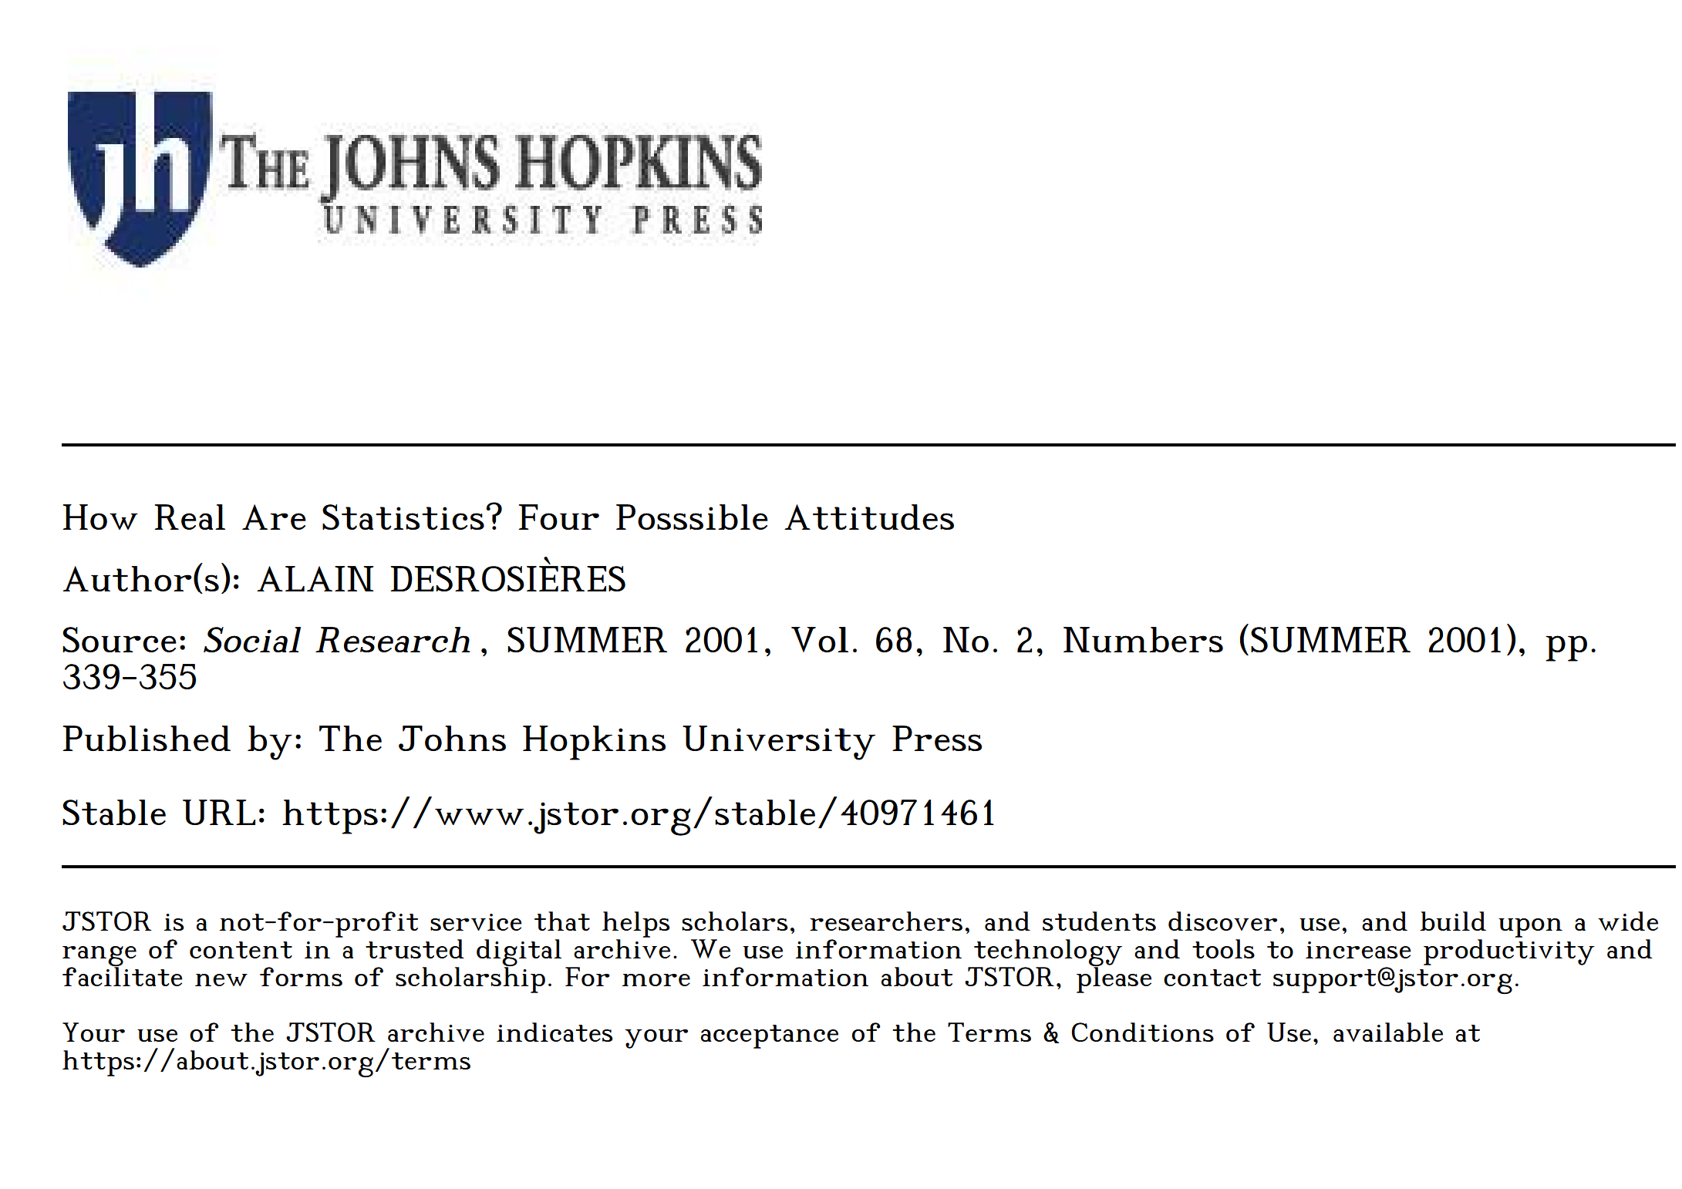
Topic 2
How do different views on 'reality' affect the way we create and use the SA indicators?
https://www.jstor.org/stable/40971461

Slide 4
Paper introduction
Sustainability Assessment of Urban Systems

Slide 5
Paper introduction (2A and 2B)
To read : Web search + pp. 339-340
Who is the author? What is his expertise ?
What is the scope of the journal ?
What is the research question raised by the authors ? What are the methods ?

Slide 6
Key concepts
Sustainability Assessment of Urban Systems

Slide 7
Group 2A and 2B
To read : pp 339-340
According to the author, why is it important to pay attention to the difference between “Approximation” and “reflection” ?

Slide 8
Four attitudes toward indicators
Sustainability Assessment of Urban Systems

Slide 9
Group 2A and 2B
To read : pp 339-340
Four attitudes towards the indicator production and understanding are presented in the article.
How can they be identified by the authors ?
List the four different attitudes presented in the article ?

Slide 10
1. Metrological Realism
Sustainability Assessment of Urban Systems

Slide 11
Group 2A
To read : pp 340 - 342
What is the origin of the “metrological realism” attitude toward the indicators/statistics ?
What is the core assumption about the reality regarding this attitude, quoted by the author ?

Slide 12
Group 2A
To read : pp 340 - 342
To your understanding, who are the key stakeholders that might support the attitude of metrological realism in the field of sustainability assessment ?

Slide 13
2. Pragmatism of accounting / “Business” accounting
Sustainability Assessment of Urban Systems

Slide 14
Group 2A
To read : pp 342 - 346
What is the main distinction between metrological realism and business accounting as discussed in the text?
In this attitude, explain why the “accountants” are doing and why they play a very important role.

Slide 15
Group 2A
To read : pp 342-346
Who are the key stakeholders that might support the attitude of “Business” accounting” in the field of sustainability assessment ?

Slide 16
3. Use for argumentation (“Proof in use”)
Sustainability Assessment of Urban Systems

Slide 17
Group 2B
To read : pp 346 - 348
What characterizes the third attitude presented in the article?
What is the "metadata paradox," and how does it affect users' interaction with statistical data?

Slide 18
Group 2B
To read : pp 346-348
Who are the key stakeholders that might support the attitude of Use for argumentation (“Proof in use”) in the field of sustainability assessment ?

Slide 19
4. Constructivists
Sustainability Assessment of Urban Systems

Slide 20
Group 2B
To read : pp 350-end
According to the authors the statistical activity seems to be more complex than just collecting and ordering data into indicators. Explain why negotiation is necessary and use an example from the text.

Slide 21
Group 2B
To read : pp 350-end
On page 352, the author argues that statistical work both reflects and constructs our understanding of "reality." Can you explain the reasoning behind this claim?
Explain with your own words how the “constructivist” attitude understand the indicators.

Slide 22
Synthesis : implications for SA
Sustainability Assessment of Urban Systems

Slide 23
Group 2A and 2B
  How does understanding these four attitudes enhance our comprehension of the construction and use of indicators in sustainability assessments?

